Slide 1
TRADITIONAL METHODOLOGIES
V-Model (Verification and Validation model)

Slide 2

Understanding traditional methodologies
Definition:Traditional methodologies are structured, sequential approaches to project management
Types:
Waterfall
V-Model
Spiral Model
iterative model
4
Topic 4

Slide 3
Process of the V-Model
Verification Phase (Left Side of the V)
Requirement Analysis (Understanding user needs and defining system requirements)
System Design (Translating requirements into a high-level system architecture.)
Architectural Design(Defining modules, components, and their interactions)
Module Design(Creating detailed designs for individual modules)
Coding(Writing and implementing the software)
Validation Phase (Right Side of the V)
Unit Testing (Testing individual modules for correctness)
Integration Testing(Ensuring modules work together as expected)
System Testing(Validating the entire system against requirements)
Acceptance Testing( Confirming the system meets user expectations)

Slide 4
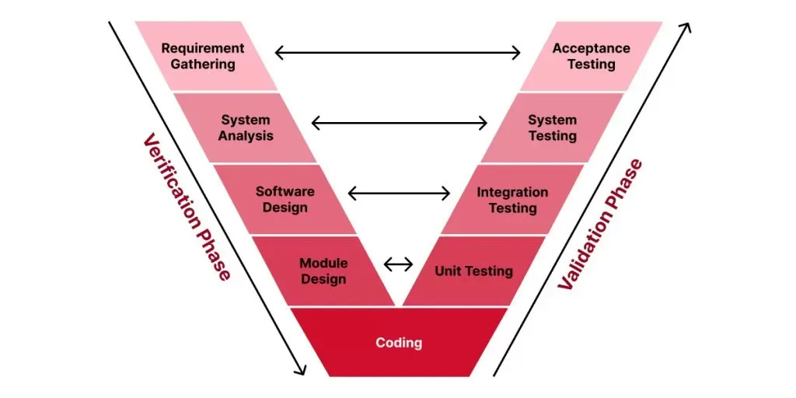
VISUAL REPRESENTATION OF V-MODEL

Slide 5
ADVANTAGES AND DRAWBACKS
Advantages
Predictability
Documentation
Stakeholder Alignment
Suitability
Drawbacks
Limited Flexibility
Long Development Cycles
Resource Heavy
Risk of Late Failures

Slide 6
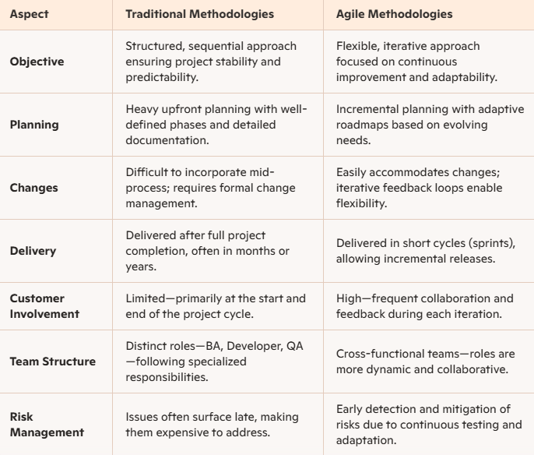
TRADITIONAL vs AGILE

